Slide 1
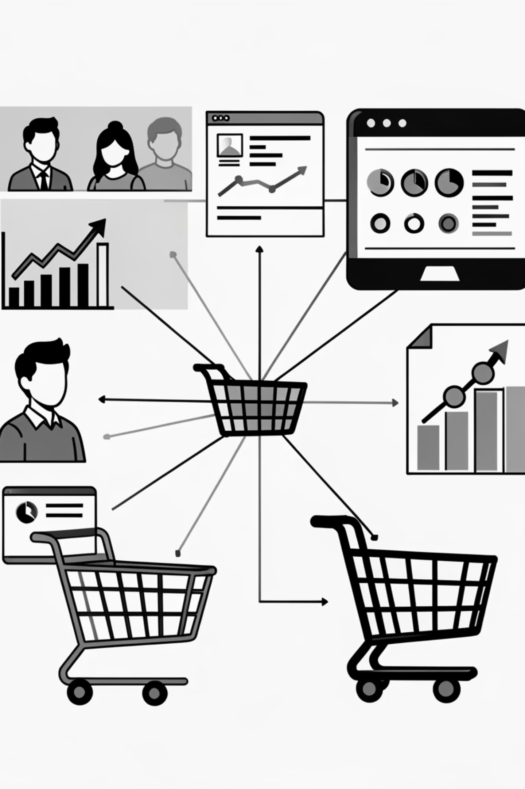
Customer Shopping Behavior Analysis
Uncovering insights from transactional data to guide strategic business decisions.

Slide 2
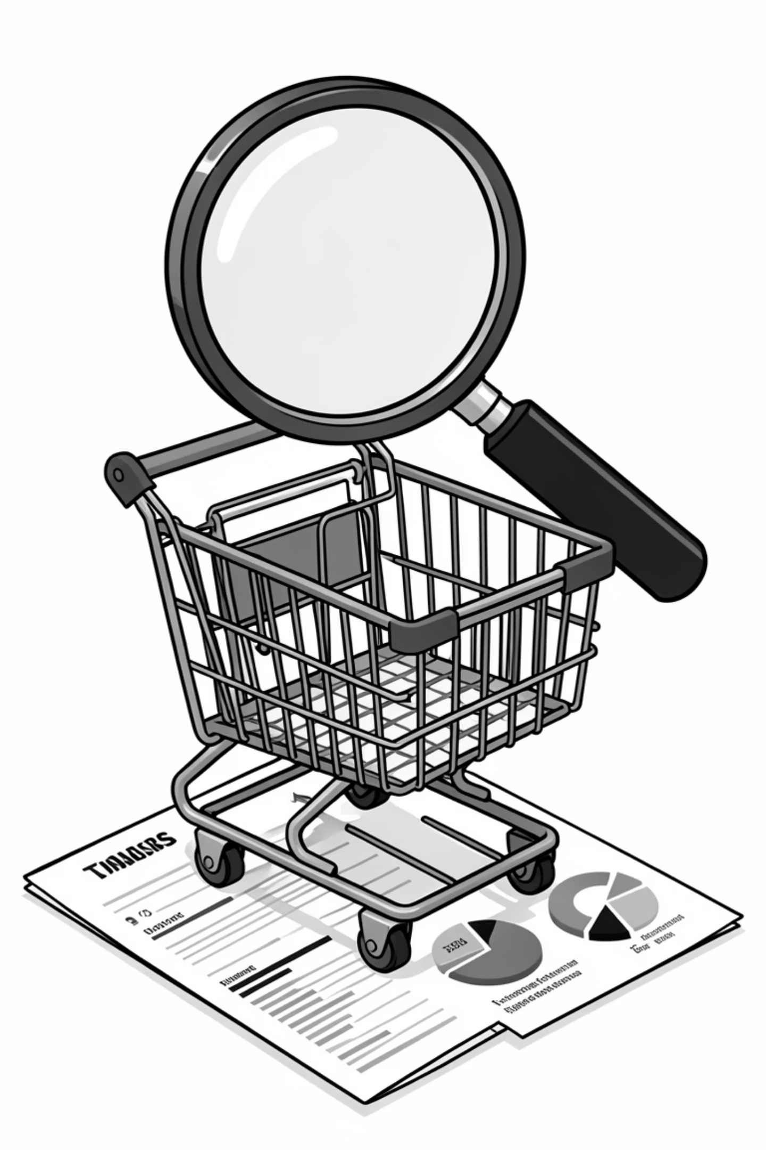
Project Overview
1
2
Analyze Data
Uncover Insights
3,900 purchases across categories.
Spending patterns, segments, preferences.
3
Guide Decisions
Optimize operations, target marketing.

Slide 3
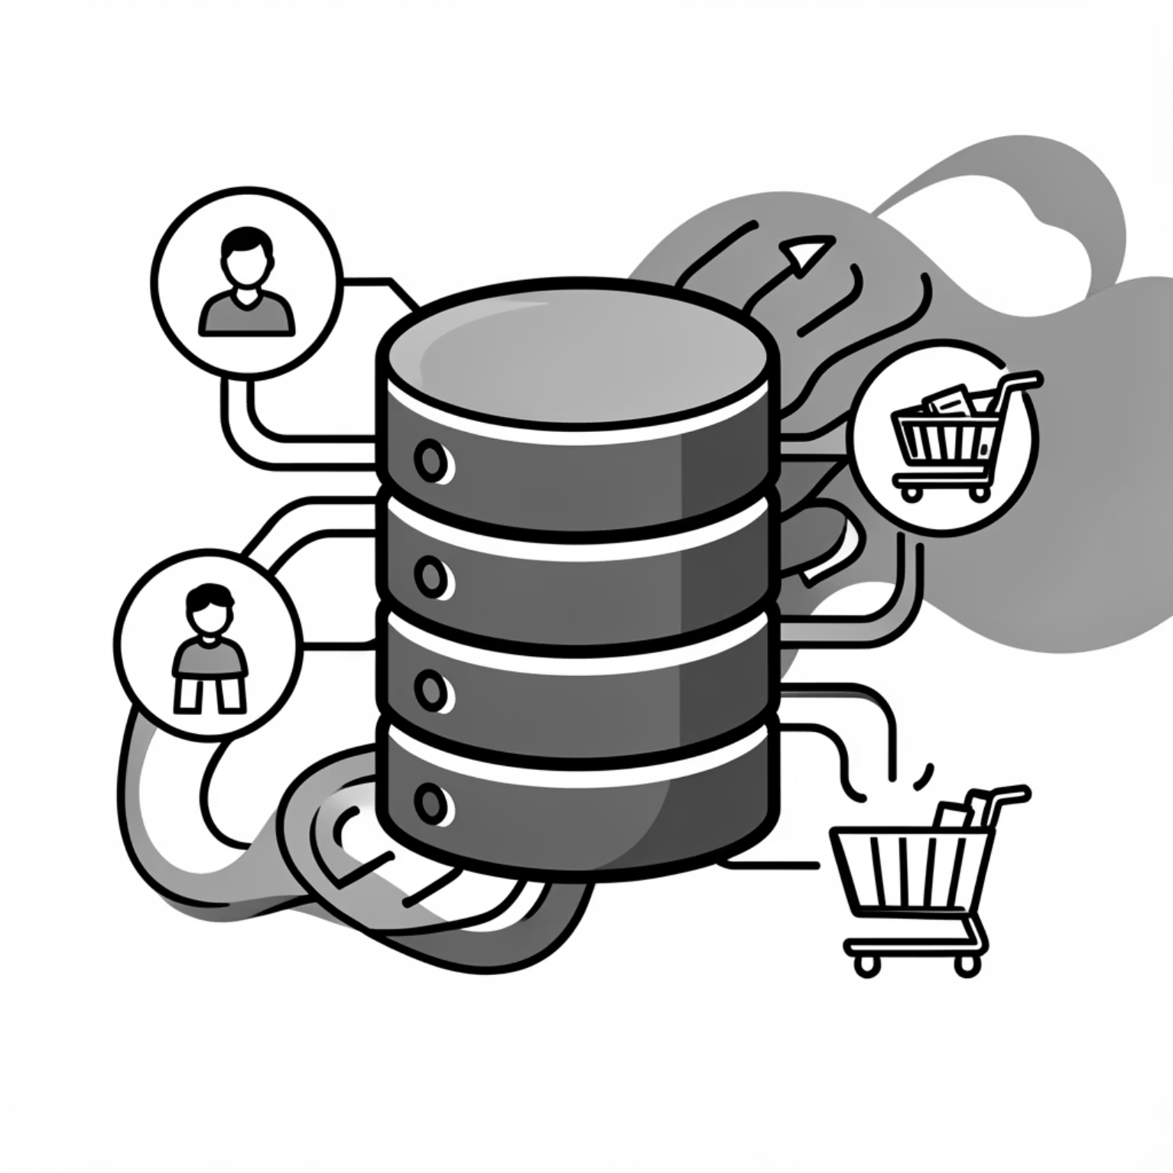
Dataset Summary
Rows: 3,900
Columns: 18
Key Features: Demographics, Purchase Details, Shopping Behavior
Missing Data: 37 values in Review Rating

Slide 4
Exploratory Data Analysis (Python)
01
02
03
Data Loading & Exploration
Missing Data Handling
Column Standardization
Imported with pandas, checked structure.
Imputed Review Rating with median.
Renamed to snake_case.
04
05
Feature Engineering
Database Integration
Created age_group, purchase_frequency_days.
Loaded into PostgreSQL for SQL analysis.

Slide 5
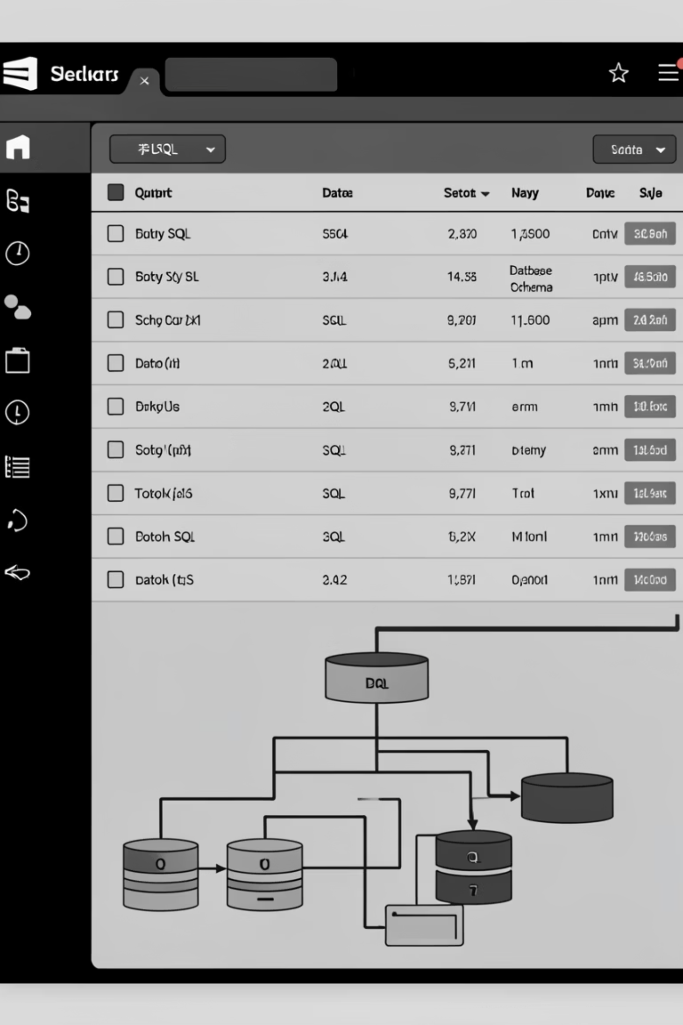
Data Analysis (SQL)
Revenue by Gender
1
Female: $75,191, Male: $157,890
High-Spending Discount Users
2
839 customers spent above average.
Top 5 Products by Rating
3
Gloves (3.86), Sandals (3.84), Boots (3.82).
Shipping Type Comparison
4
Standard: $58.46, Express: $60.48.

Slide 6
SQL Insights: Subscriptions & Discounts
Subscribers vs. Non-Subscribers
Discount-Dependent Products
Hat: 50.00%
Yes
1053
59.49
Sneakers: 49.66%
No
2847
59.87
Coat: 49.07%
Sweater: 48.17%
Pants: 47.37%

Slide 7




Customer Segmentation
New
83 Customers
Loyal
3116 Customers
Returning
701 Customers

Slide 8
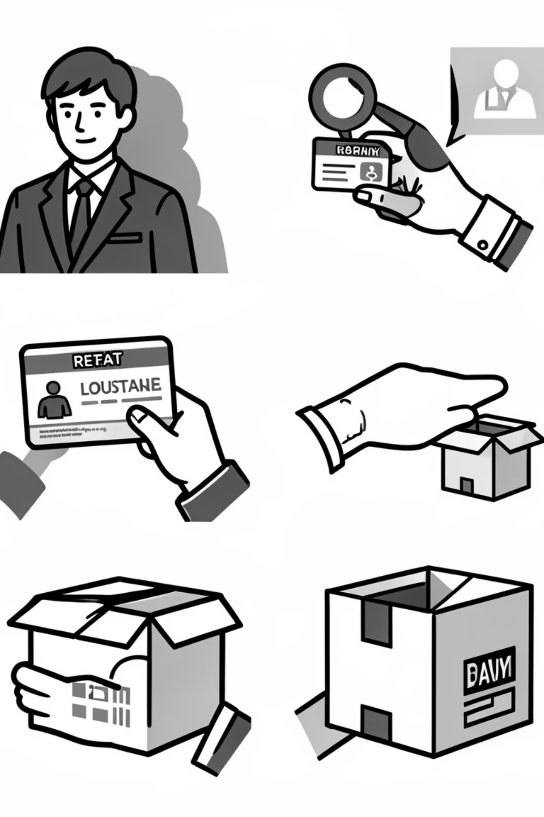
Top Products & Repeat Buyers
Top 3 Products per Category
Repeat Buyers & Subscriptions
Accessories: Jewelry, Sunglasses, Belt
Customers with >5 purchases:
No Subscription: 2518
Clothing: Blouse, Pants, Shirt
Yes Subscription: 958
Footwear: Sandals, Shoes, Sneakers
Outerwear: Jacket, Coat

Slide 9
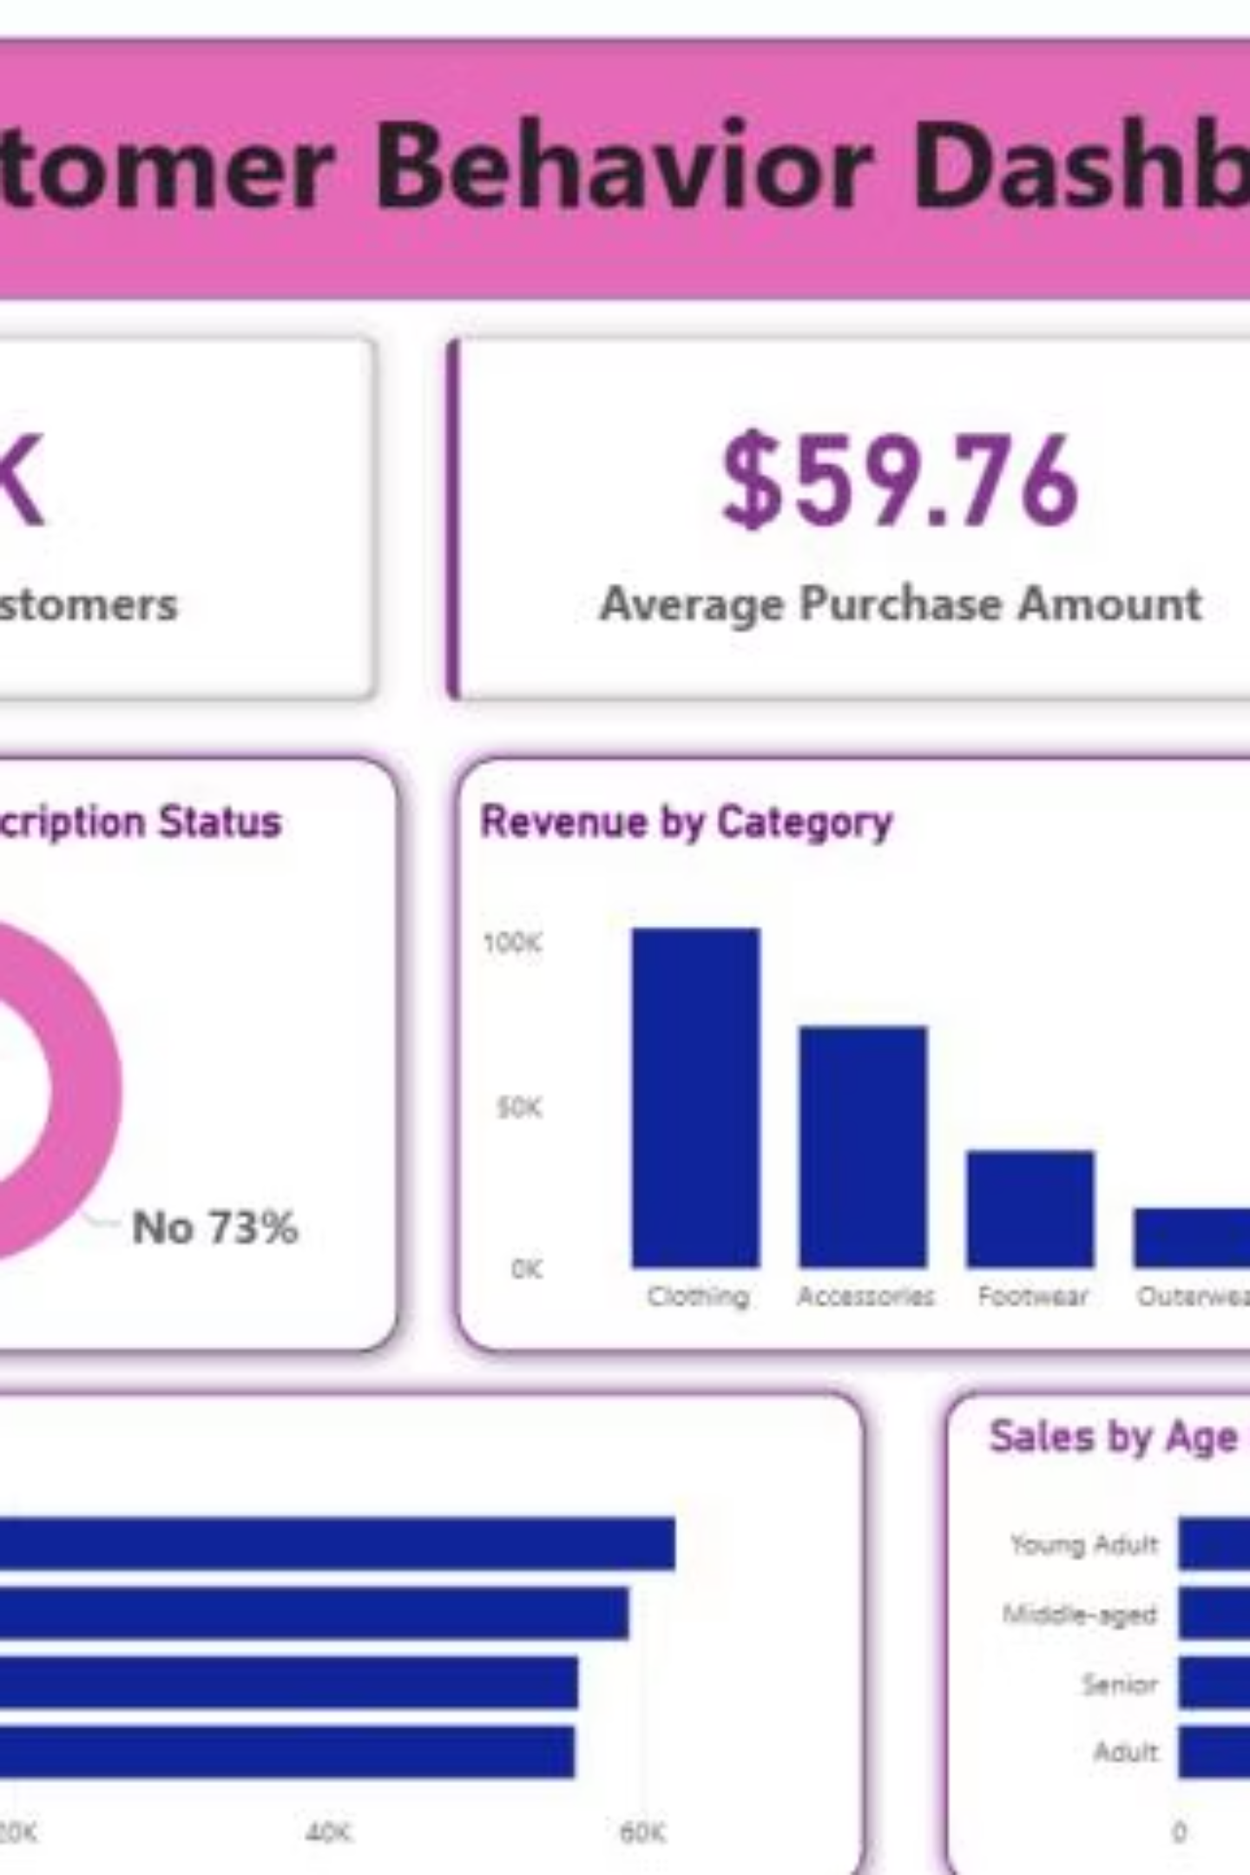
Power BI Dashboard
Interactive dashboard for visual insights:
Key Metrics: 3.9K Customers, $59.76 Avg Purchase, 3.75 Avg Review
Subscription Status: 73% No, 27% Yes
Revenue by Category: Clothing (100K), Accessories (70K)
Revenue by Age Group: Young Adult (65K), Middle-aged (55K)

Slide 10

Business Recommendations
Boost Subscriptions
Promote exclusive benefits.
Customer Loyalty
Reward repeat buyers.
Review Discount Policy
Balance sales with margin.
Targeted Marketing
Focus on high-revenue groups.

